Slide 1
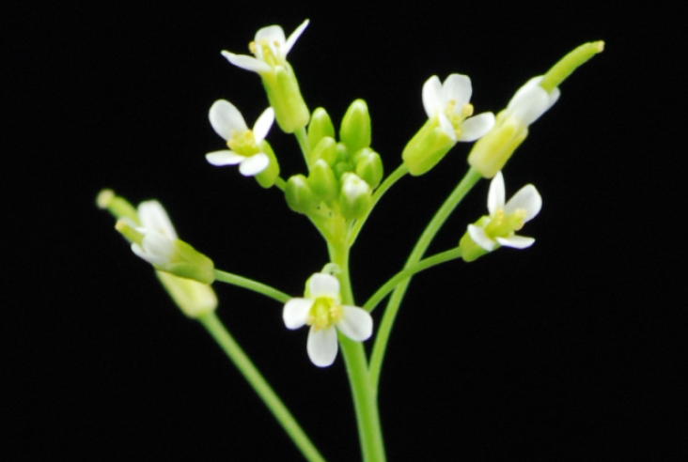



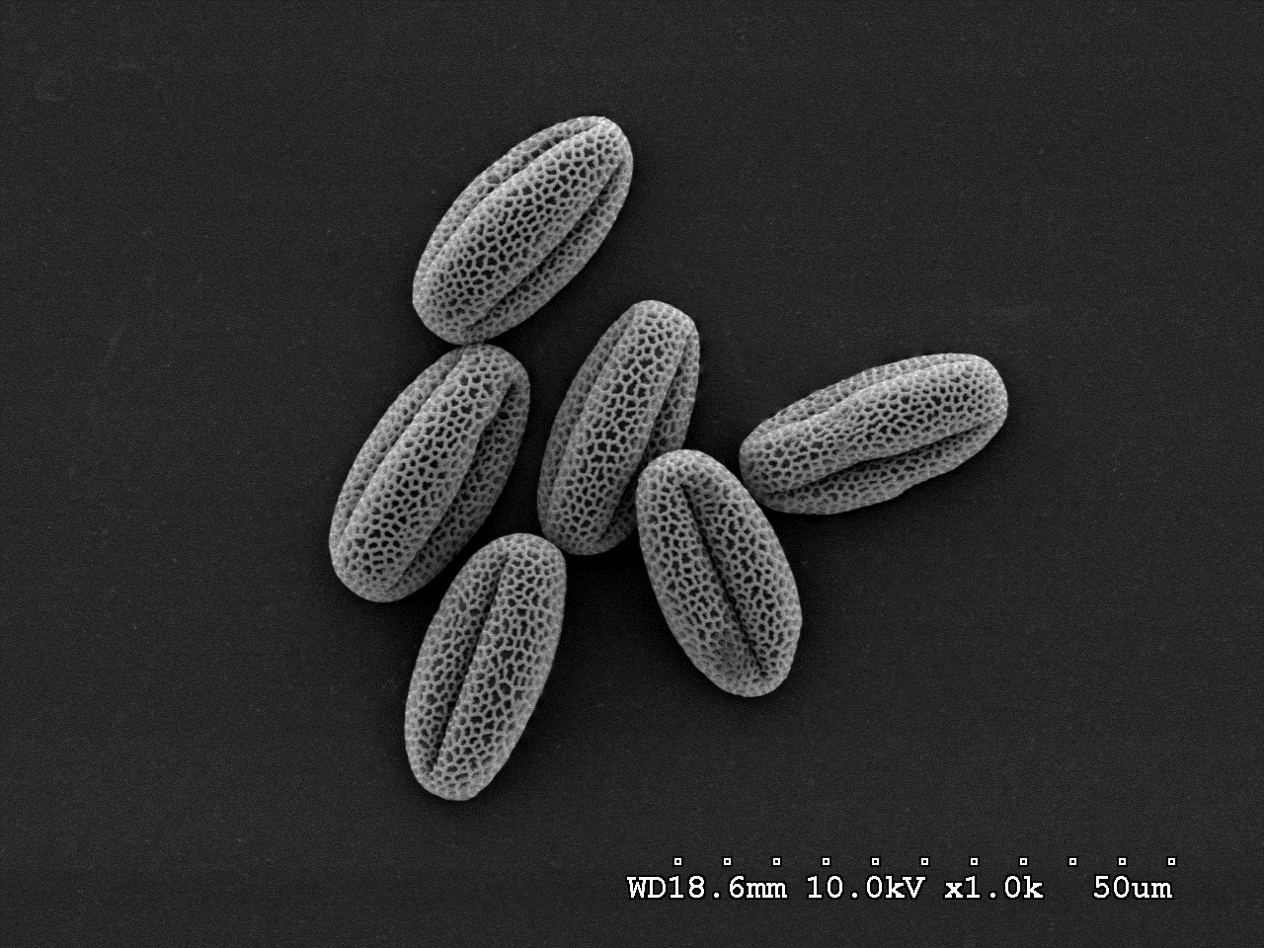
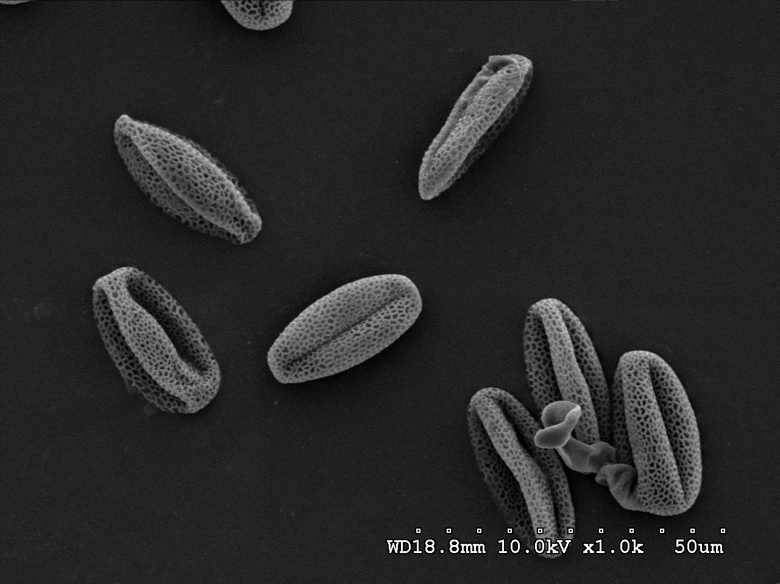
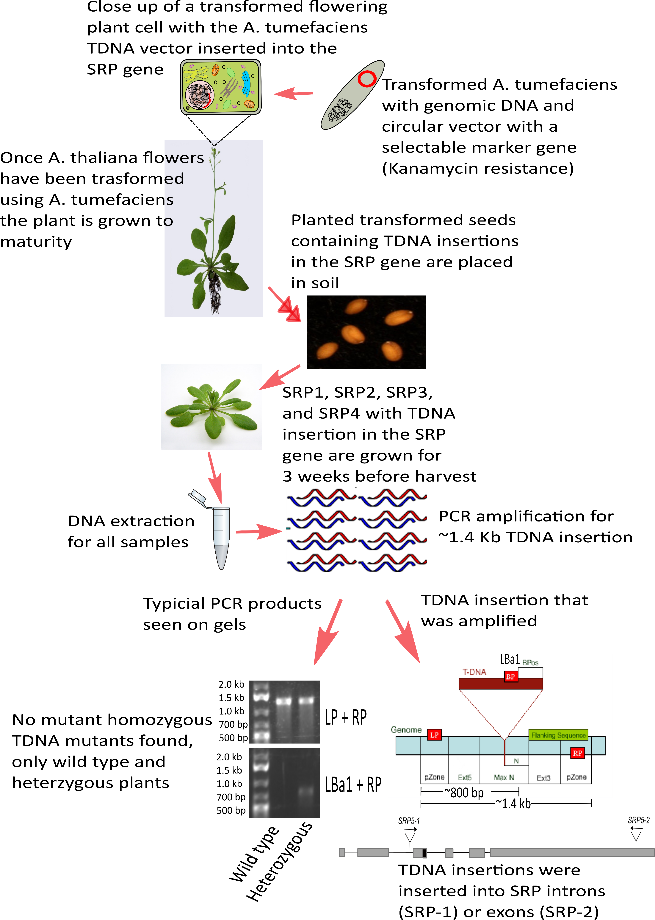
Identification of Arabidopsis thaliana Mutants Deficient in Pollen and Embryo Development
Merritt B. Burch, Yunfeng Liu & Bin Yu
School of Biological Sciences, University of Nebraska Lincoln, Lincoln NE 68508
Introduction & Background
Results
The small RNA processor (SRP) gene, only identified in metazoans until now, has recently been found in plants. Previous studies have shown that SRP plays a critical role in the transcription and processing of:
Uracil rich small nuclear RNAs
Spliceosomal RNAs
Enhancer RNAs
Because the function of SRP in plants is unknown, this study aims to find what insertional mutagenesis by Agrobacterium tumefaciens into the SRP gene does to Arabidopsis thaliana. Results could potentially shed light on the evolutionary conserved gene function in plants.
Figure 1: Wild type (Col) pollen under SEM
Figure 2: Deformed homozygous srp5-1 mutant pollen under SEM
Methods
Figure 3: Wild type homozygous (Col) pollen stained with Alexander’s stain, pollen is alive
Figure 4: Mutant heterozygous SRP5-2 pollen under light microscope, alive and dead pollen observed
Sample ID | Wild Type Homozygous | Heterozygous | Total Plants | Genotypic Ratio
SRP1-2 | 23 | 22 | 45 | 1 : 1
SRP2-2 | 27 | 25 | 52 | 1 : 1
SRP3-2 | 10 | 29 | 39 | 1 : 3
SRP4-2 | 17 | 32 | 49 | 1 : 2
SRP5-1 | 15 | 29 | 44 | 1 : 2
Table 1: Summary of PCR results showing the number of wild type and heterozygous plants that contain the TDNA insertion in the SRP gene. No homozygous mutants were found.
Discussion & Conclusion
Our results show that:
Only heterozygous and wild type plants were alive
Mutant pollen was deformed or non-viable when compared to wild type pollen
Homozygous mutant plants possibly not found because SRP mutation caused pistil, stamen death, or embryo death
Future work: back crossing mutant and wild type pistils and stamens in attempt to determine whether pistil, stamen, or embryo death is creating the heterozygous and WT mutants observed
Acknowledgements: We would like to thank the NSF for the financial support of this project.

